Slide 1
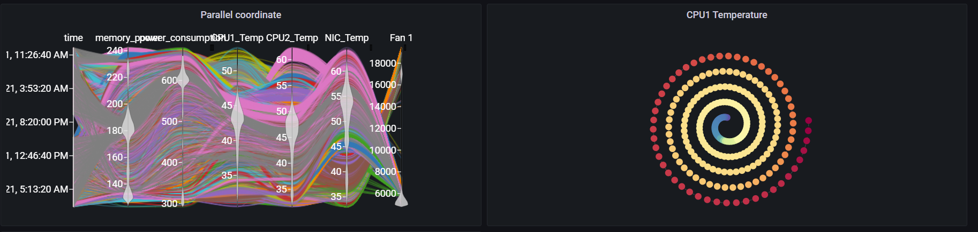
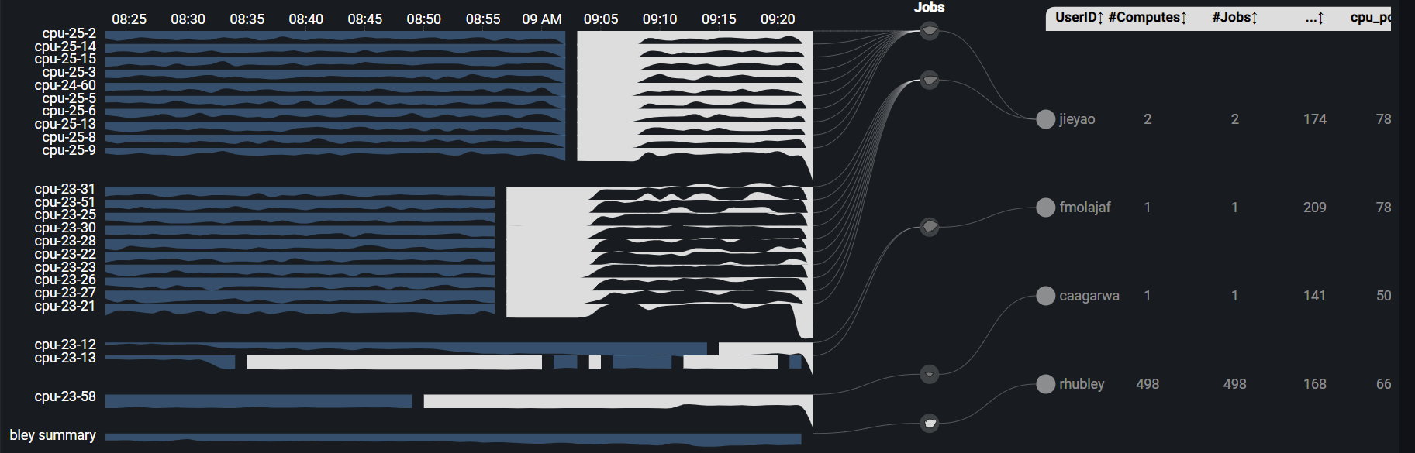
Grafana Plugin
Weekly report

Slide 2
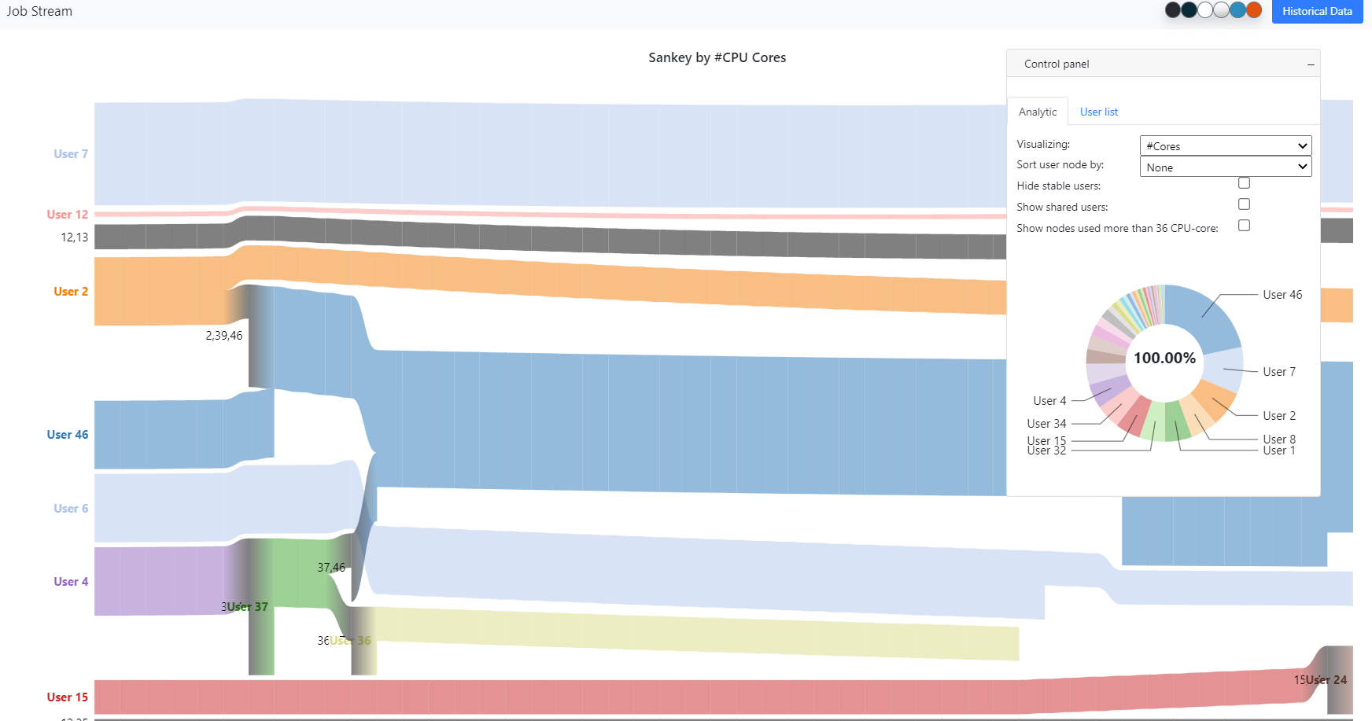
Sankey

Slide 3
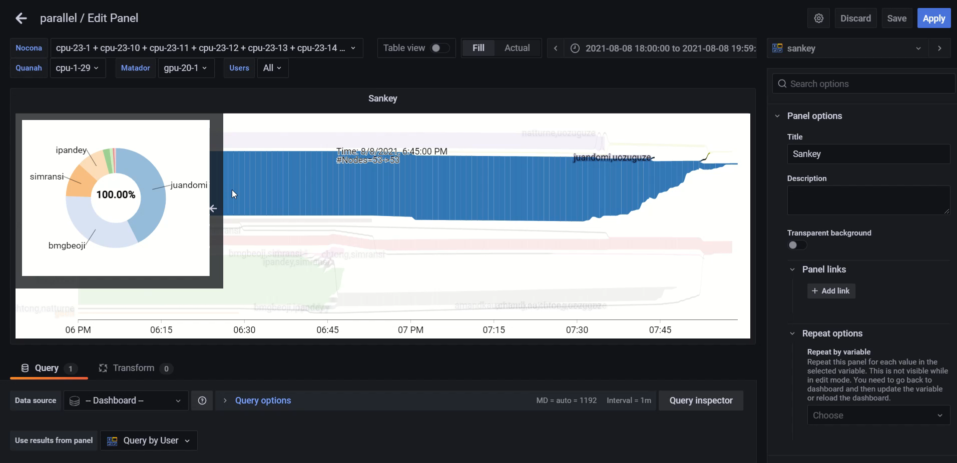
Previous result

Slide 4
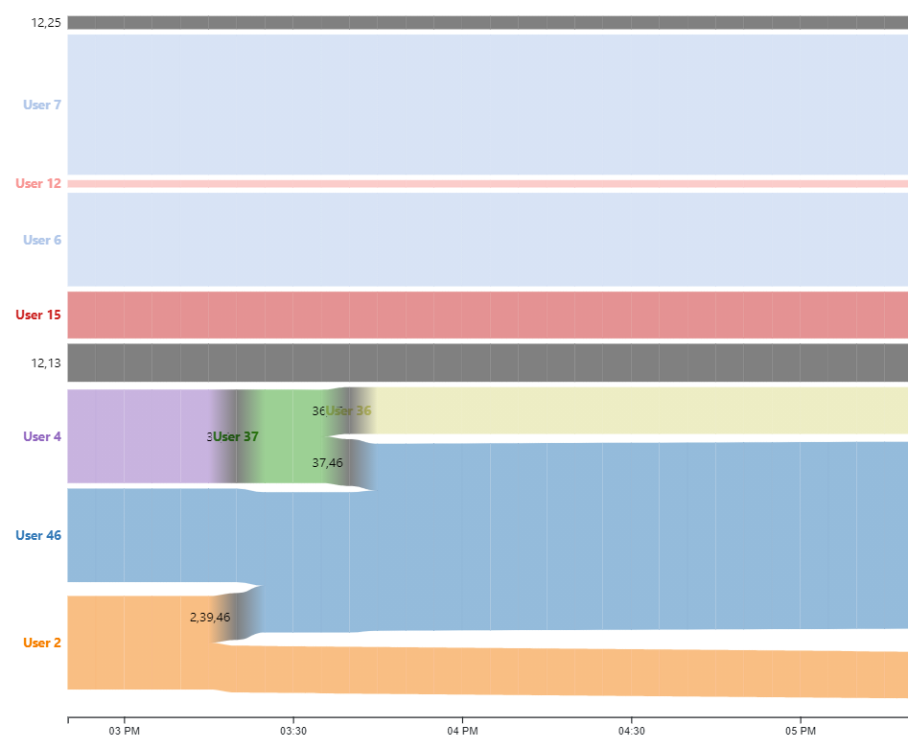
Current result
Before
After

Slide 5
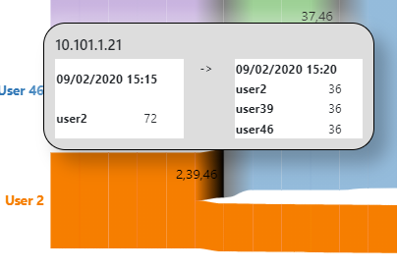
Current result
Max core for a compute is 36, if user use more than 36 then ignore the different

Slide 6
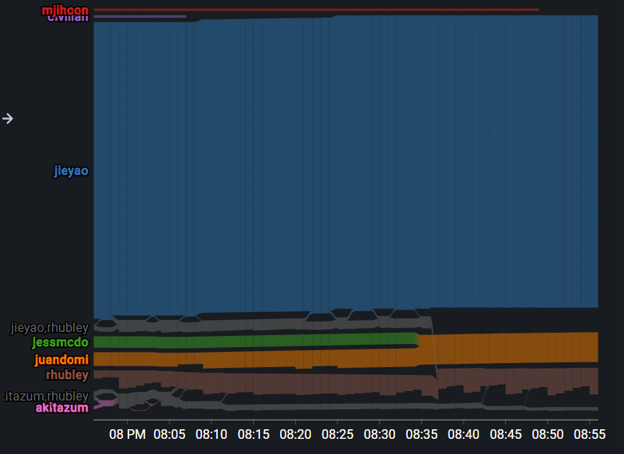
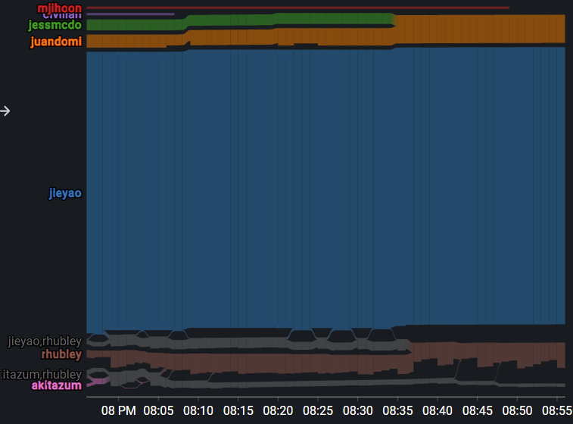
Current result
Before
After
crossing

Slide 7
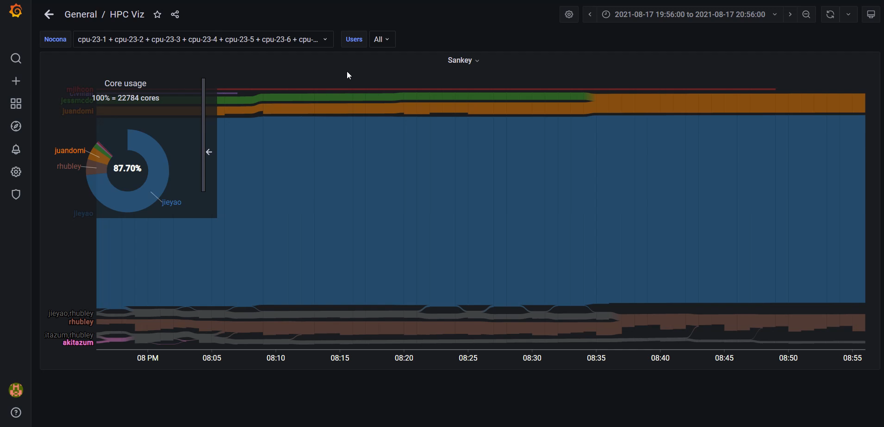
Current result

Slide 8
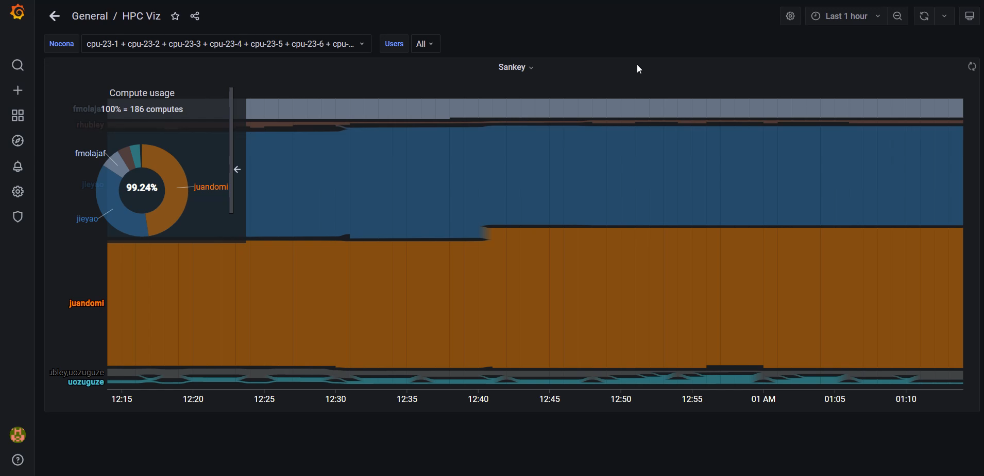
Current result

Slide 9
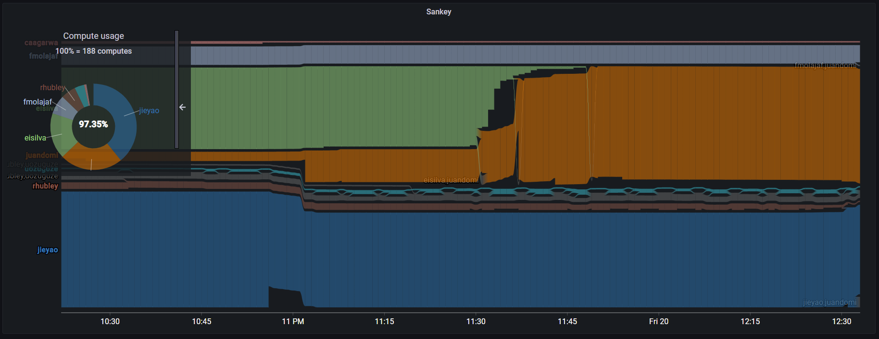
Current result
8/19/2021 22:22:00 to 8/20/2021 01:22:00
Compute usage

Slide 10

Current result
8/19/2021 22:22:00 to 8/20/2021 01:22:00
Core usage

Slide 11
Current features
Sankey by #cores/computes
Zoom/Pan
Summary pie chart for Core/Compute usage
Adjust stream order

